Slide 1
Apriori Parallel Data Mining
CP431/631
Term Project
Omer Tal
Elizabeth Gorbonos
Tianran Wang

Slide 2
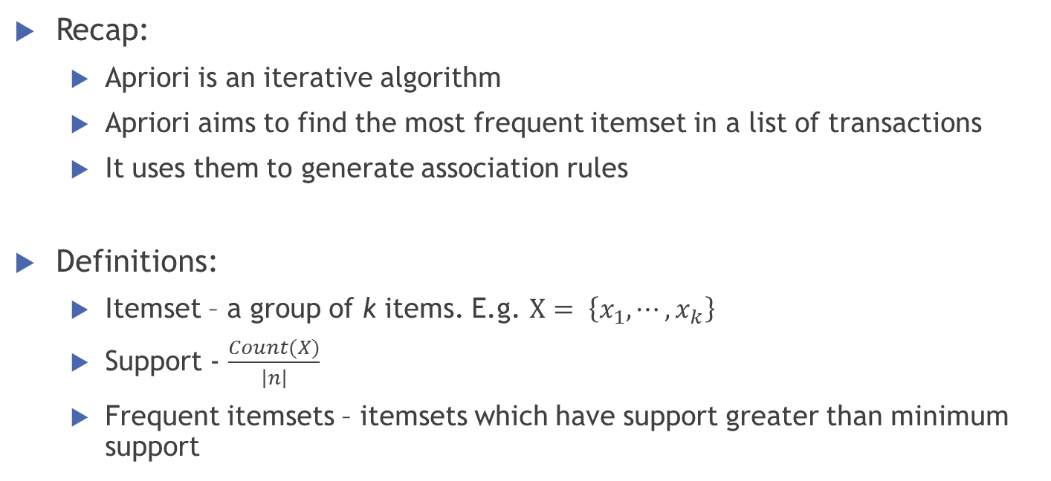
Apriori Algorithm
Recap:
Apriori is an iterative algorithm
Apriori aims to find the most frequent itemset in a list of transactions
It uses them to generate association rules
Definitions:
Itemset – a group of k items. E.g. $X= \left\{x_{1}, ⋯, x_{k}\right\}$
Support - $\frac{Count(X)}{\left|n\right|}$
Frequent itemsets – itemsets which have support greater than minimum support

Slide 3
Min support =50%
Database D
L₁
C₁
Scan D
C₂
C₂
L₂
Scan D
C₃
Scan D
L₃

Slide 4
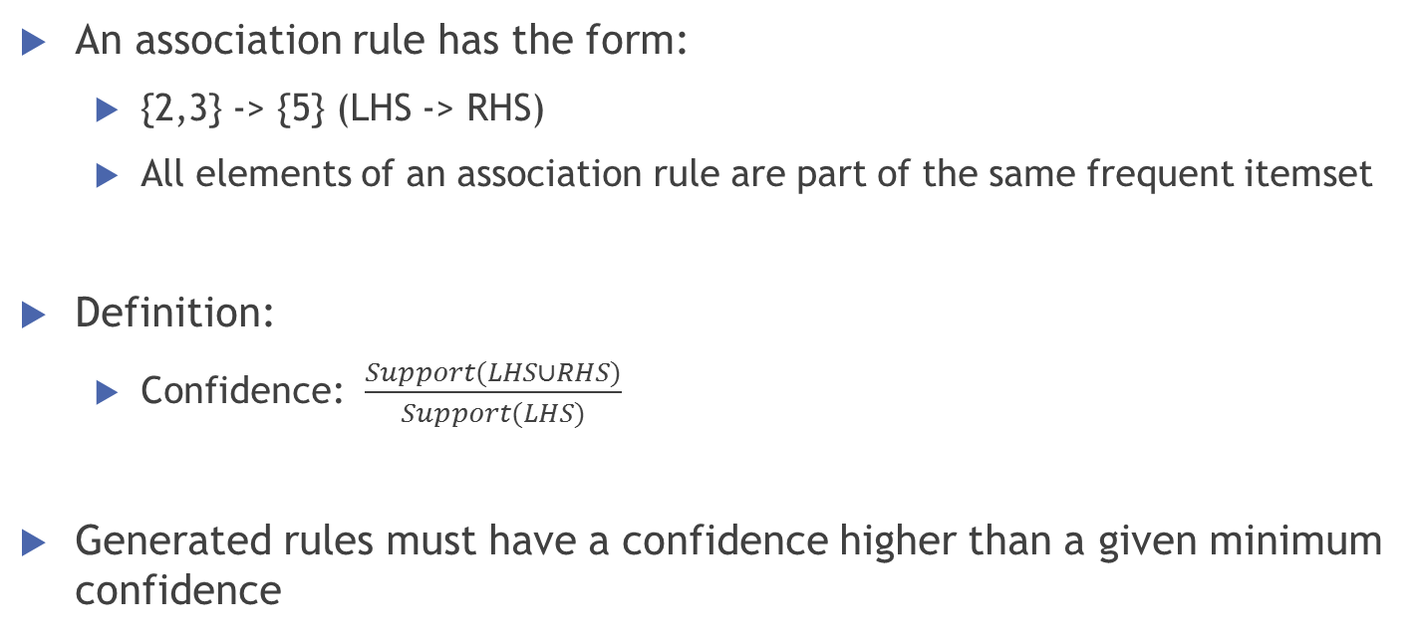
Association rules
An association rule has the form:
{2,3} -> {5} (LHS -> RHS)
All elements of an association rule are part of the same frequent itemset
Definition:
Confidence: $\frac{Support(LHS∪RHS)}{Support(LHS)}$
Generated rules must have a confidence higher than a given minimum confidence

Slide 5
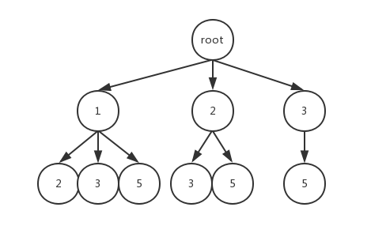
Serial Algorithm
The serial program is written in python
Data structures:
All transactions are stored in a list
The items in each transaction are represented by a dictionary
Allows to check if an item exists in a transaction in O(1)
A tree was implemented to manage the candidates
Allows to prune the candidate space
Transactions are removed when deemed irrelevant
For example when a transaction contains no frequent itemsets

Slide 6
Parallel Algorithm
The parallel program uses MPI4py
Tested two load balancing versions
Static
Centralized dynamic
The parallelized section was finding the frequent items
All counting results are gathered in process 0
Process 0 generates the next level candidates, build the candidate tree and broadcasts it.
The iterations come to an end when an END signal is broadcasted.
Rules generation remained serial - took on average 0.01s

Slide 7
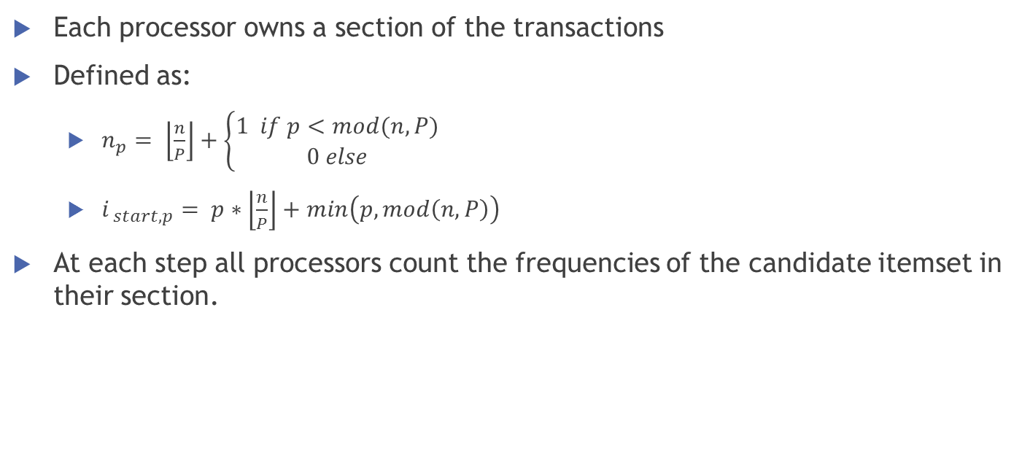
Static Load Balancing
Each processor owns a section of the transactions
Defined as:
$n_{p}= \left\lfloor \frac{n}{P}\right\rfloor +\left\{\begin{matrix}1 if p<mod(n,P) \\ 0 else\end{matrix}\right.$
$i_{ start,p}= p∗\left\lfloor \frac{n}{P}\right\rfloor +min\left(p,mod\left(n,P\right)\right)$
At each step all processors count the frequencies of the candidate itemset in their section.
1 3 4
2 3 5
1 2 3 5
2 5
P0
P1

Slide 8
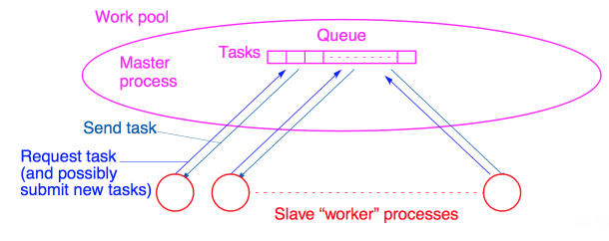
Centralized Dynamic Load balancing
In each iterations:
A designated Master process partitions the transactions
Slaves are assigned one partition at a time
A slave sends the Master the following:
The frequencies count (a dictionary)
A filtered list of transactions
A request for a new partition
Results

Slide 9
Datasets
Used the following datasets
Dataset | No. transactions | No. unique items | Density | Support | Confidence
DS1 | 88,162 | 16,470 | 0.06% | 0.01 | 0.6
DS2 | 25,900 | 4,071 | 0.51% | 0.01 | 0.6
DS3 | 119,578 | 1,728 | 0.39% | 0.001 | 0.3
DS4* | 4,627 | 111 | 16.69% | 0.15 | 0.85
DS5** | 1,057,944 | 16,470 | 0.06% | 0.01 | 0.6
* Taken from WEKA
** Linear expansion by 12 of DS1

Slide 10
Results – DS2
Notes:
Static worked best at 8 CPUs – speedup of 2.9
Dynamic was in fact a slowdown – dataset is relatively small and the dynamic version uses a lot of communication

Slide 11
Results – DS4
Notes:
Static – got a speedup of 14 (32 CPUs)
Dynamic – got to a max speedup of 3.2 at 16 CPUs

Slide 12
Results
DS2:
4 Levels of 1087 frequent itemsets
Discovered 195 rules using support>0.01 and confidence>0.6
DS4:
6 levels of 2254 frequent itemsets
Discovered 370 rules using support>0.15 and confidence>0.85

Slide 13
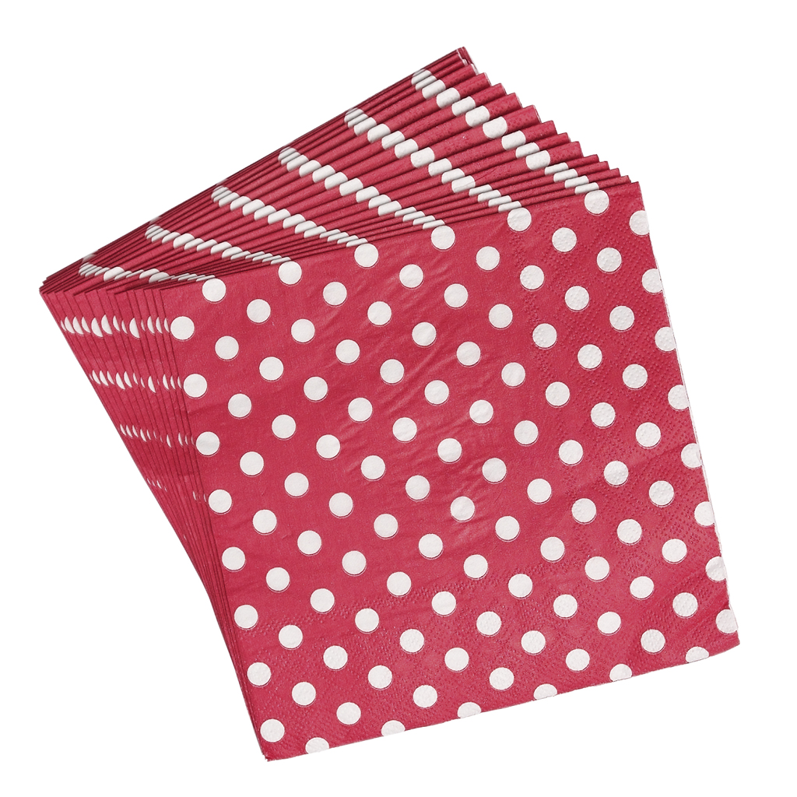
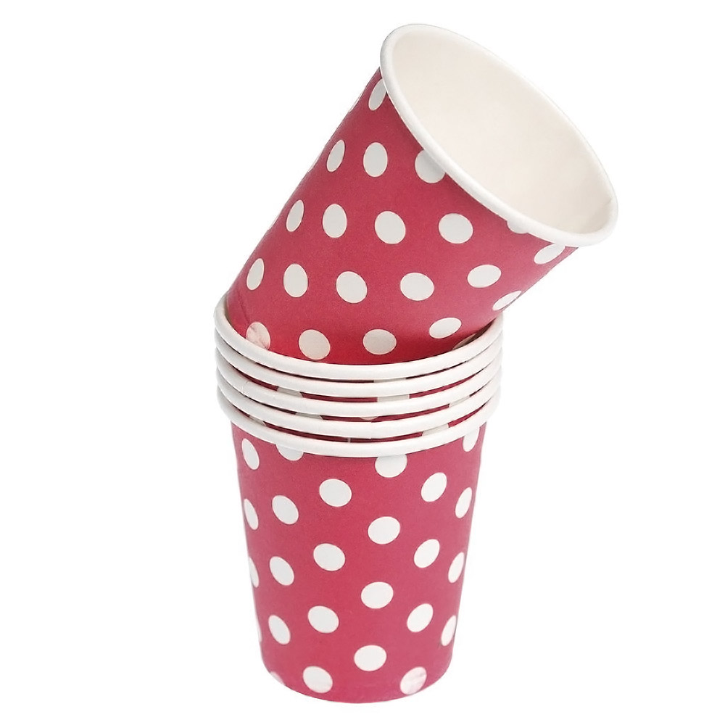
[SET/20 RED RETROSPOT PAPER NAPKINS, SET/6 RED SPOTTY PAPER CUPS]

Slide 14
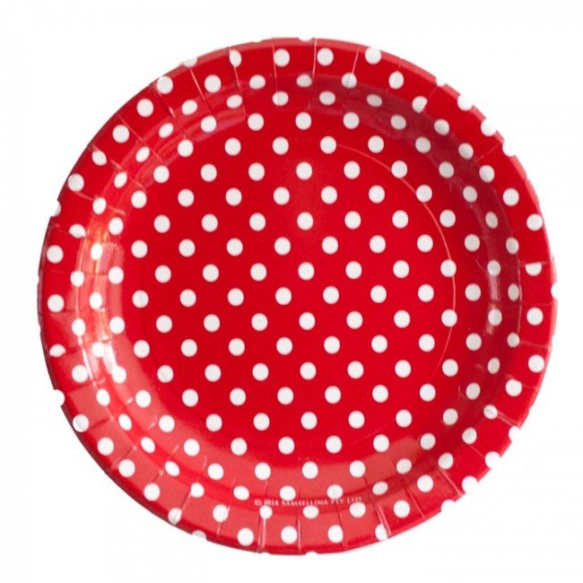
[SET/20 RED RETROSPOT PAPER NAPKINS, SET/6 RED SPOTTY PAPER CUPS] -> [SET/6 RED SPOTTY PAPER PLATES] confidence=0.895

Slide 15
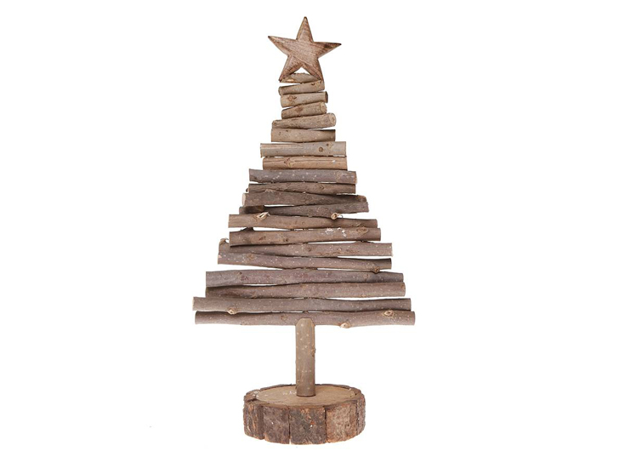
[WOODEN TREE CHRISTMAS SCANDINAVIAN] -> [WOODEN STAR CHRISTMAS SCANDINAVIAN] confidence=0.822

Slide 16


Slide 17
Rules generated
Dataset | No. levels | No. Frequent item sets | No. Rules
DS1 | 4 | Level 1 - 70 frequent itemsets Level 2 - 58 frequent itemsets Level 3 - 25 frequent itemsets Level 4 - 6 frequent itemsets | 90
DS2 | 4 | Level 1 - 598 frequent itemsets Level 2 - 404 frequent itemsets Level 3 - 82 frequent itemsets Level 4 - 3 frequent itemsets | 195
DS3 | 4 | Level 1 - 371 frequent itemsets Level 2 - 7624 frequent itemsets Level 3 - 13815 frequent itemsets Level 4 - 14 frequent itemsets | 117
DS4 | 6 | Level 1 - 39 frequent itemsets Level 2 - 346 frequent itemsets Level 3 - 947 frequent itemsets Level 4 - 767 frequent itemsets Level 5 - 153 frequent itemsets Level 6 - 2 frequent itemsets | 370
DS11 | Same results as DS1

Slide 18
Results – DS1
Notes:
Static speedup – 3.33 (16 CPUs)
Dynamic speedup – 0.68 – slowdown

Slide 19
Results – DS3
Notes:
Static – 1.83 (8 CPUs)
Dynamic – 0.6 - slowdown

Slide 20
Results – DS5
Notes:
Static – 26.4 speedup (32 cores). Superlinear speedup
Dynamic – 1.65 (8 cores)

